Slide 1
COVID Related to Happiness
Yuyan Shi
Samir Epili
Bhavna Kaparaju
Mauricio Morales

Slide 2
Dataset Description
Happiness Index Report
The report includes the happiness index and key variables, such as logged GDP per capita, for each country.
Source: Kaggle
COVID-19 Confirmed Cases
The dataset includes cumulative number of confirmed cases for each country, from Jan 22nd to July 26th.
Source: John Hopkins University

Slide 3
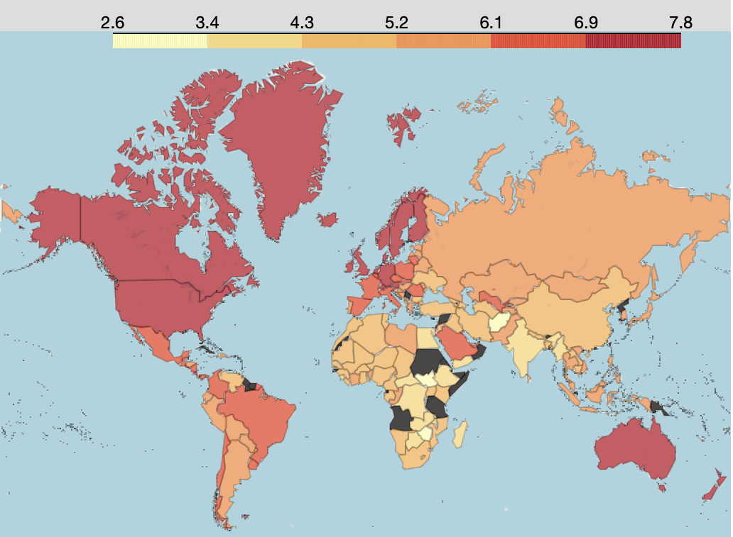
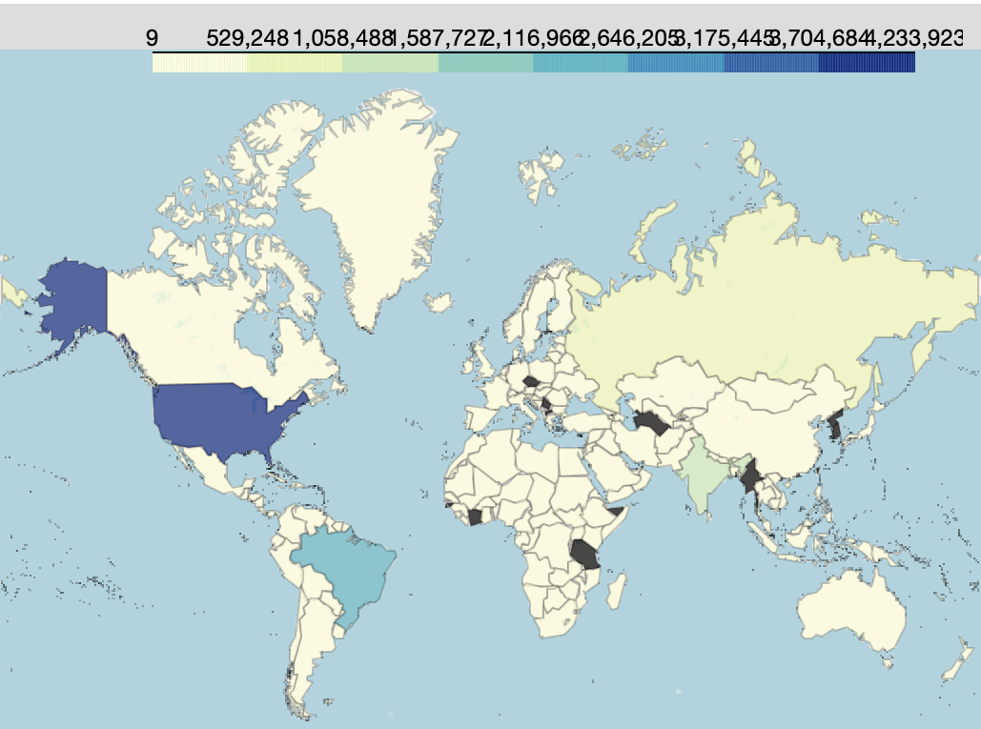
Before the formal model building
Happiness Index Heat Map
Confirmed Cases (until 7/26) Heat Map

Slide 4
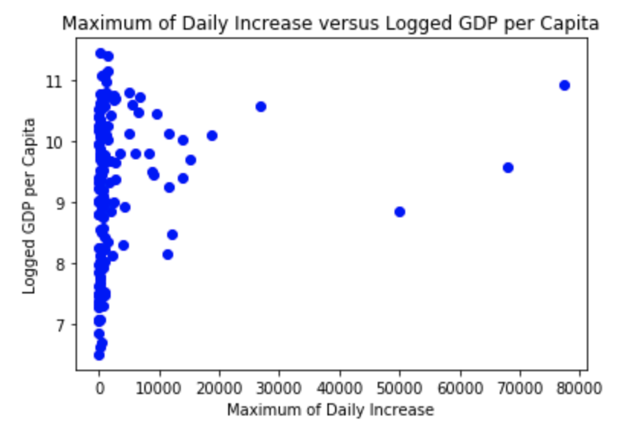
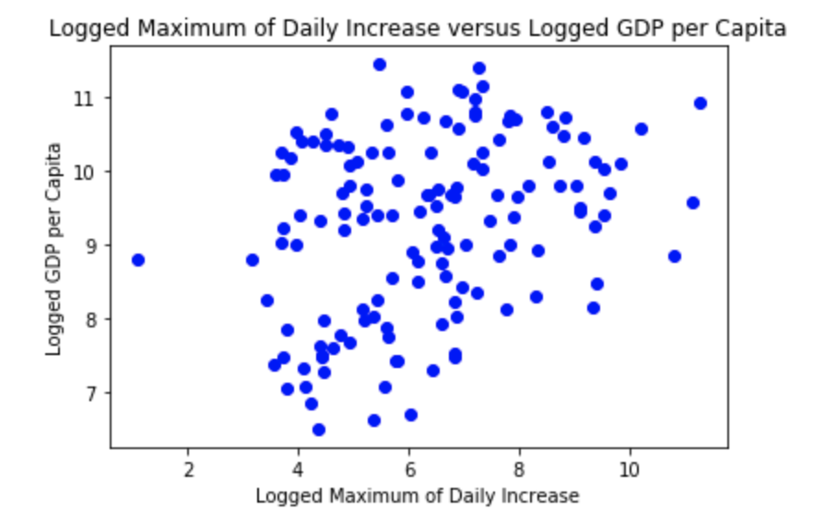
We chose the logarithm of max rate,
because of…...
the homoscedasticity assumption of linear regression model

Slide 5
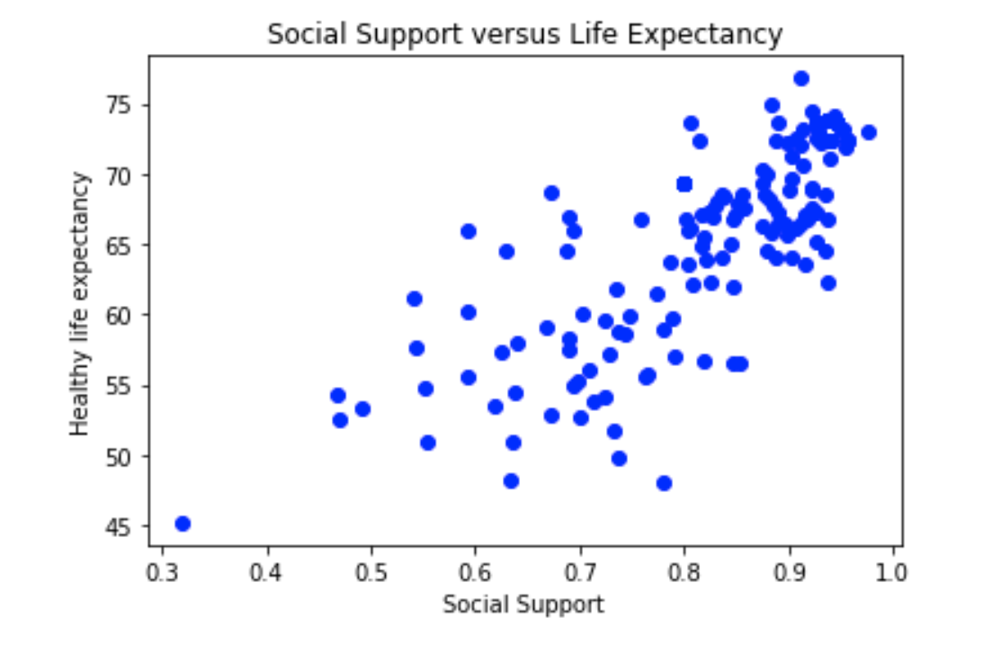
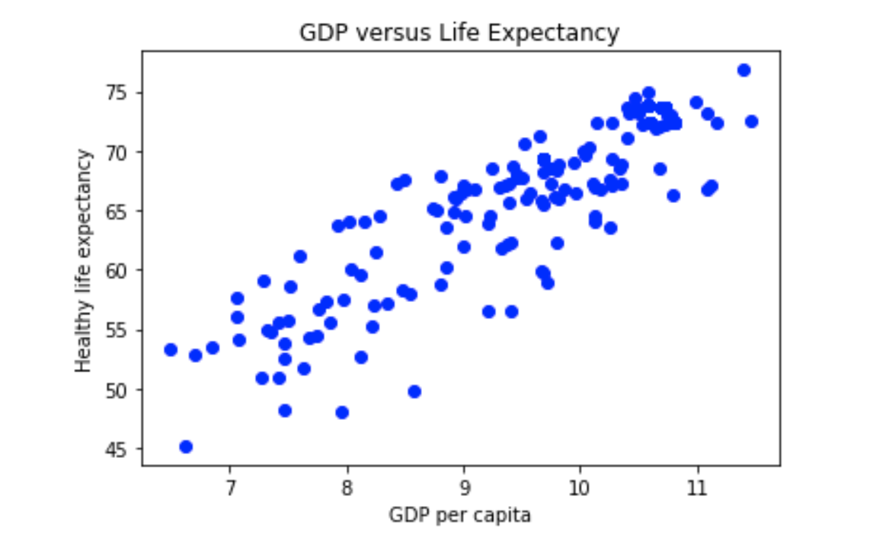
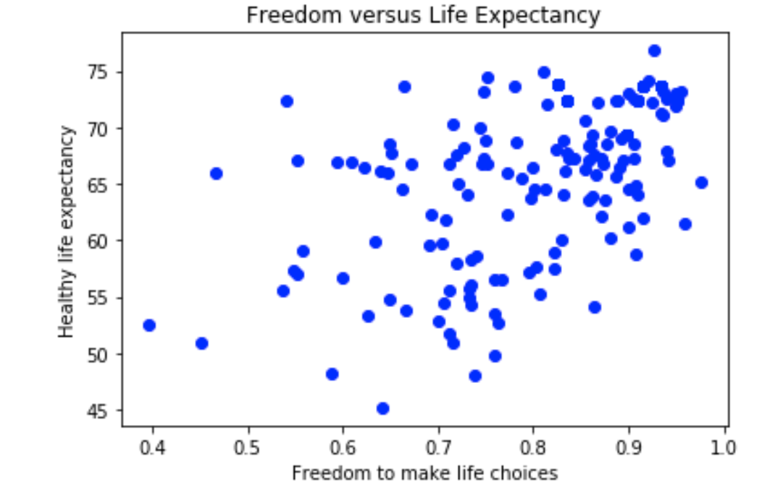
Some Exploratory Analysis in Happiness Dataset

Slide 6
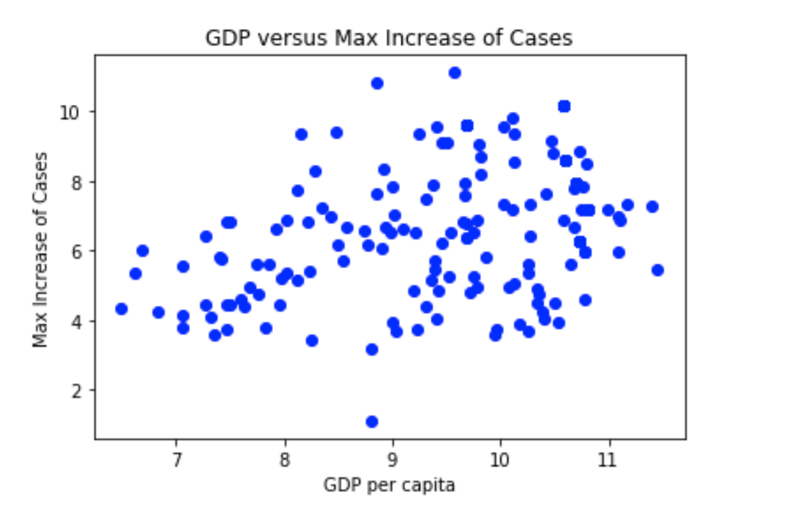
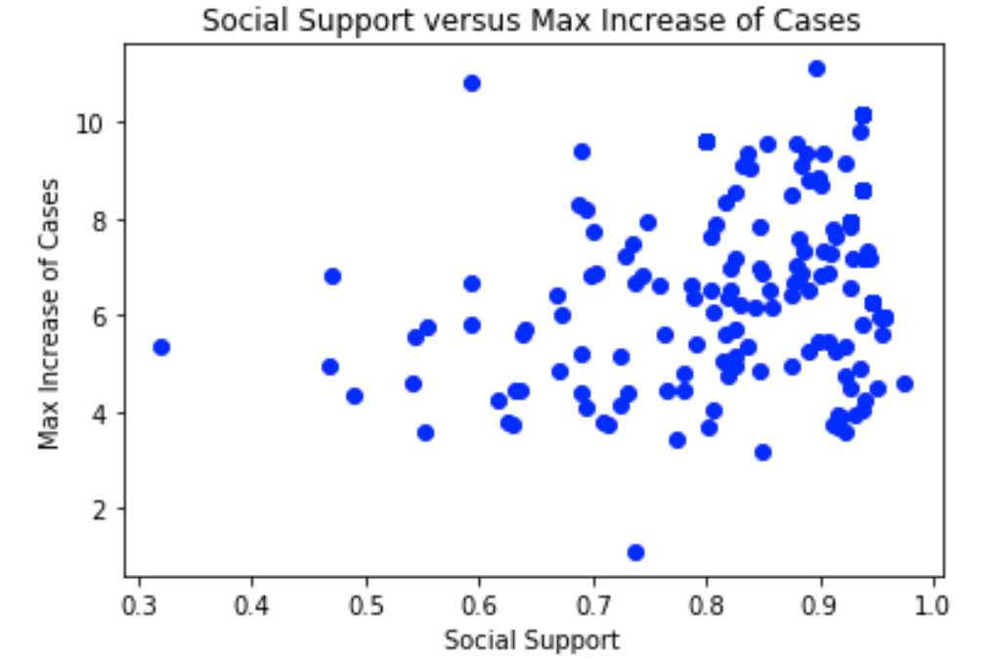
Plotting Max Rate to Variables in Happiness Report
(1/2)

Slide 7
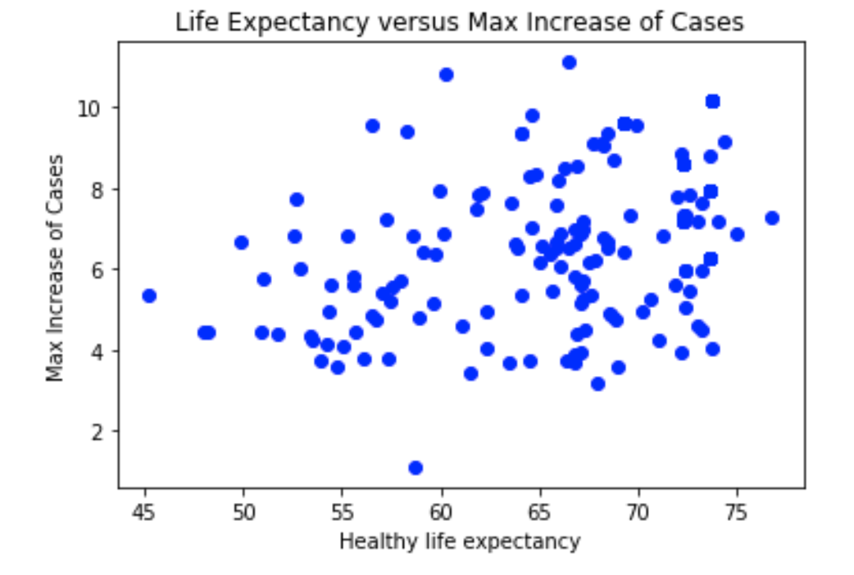
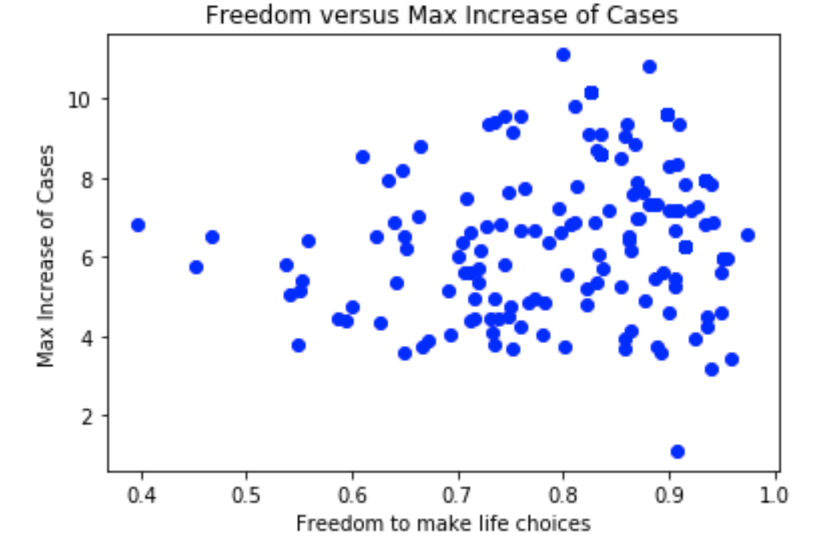
Plotting Max Rate to Variables in Happiness Report
(2/2)

Slide 8
Standard deviations of happiness predictors and maximum rate.
Variables | Standard Deviations
Ladder Score | 1.16
Logged GDP per capita | 1.12
Social support | 0.11
Healthy life expectancy | 6.66
Freedom to make life choices | 0.11
Maximum increase in infections | 2.05
Notes:
We found the standard deviation to see how well our regression models predict and so that we could understand our RMSE

Slide 9
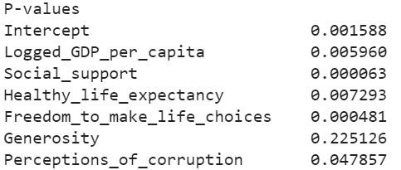
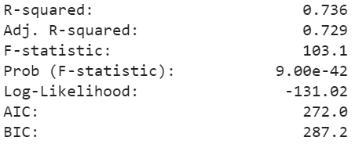
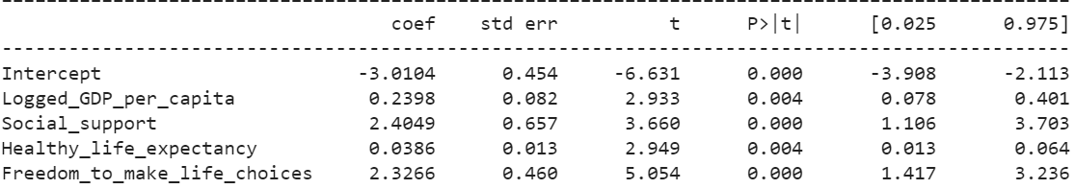
Linear Regression Model of Happiness
Notes:
Our group first created a linear regression model using only the happiness data set to find the most significant predictors of happiness. We found that the p-values of generosity and perceptions of corruption were much higher than 0.05, which indicates that they are unreliable predictors of happiness. Thus, we removed these predictors from our final model in Figure 3. The most important, non-zero variables (as indicated by the confidence intervals), were logged GDP per capita, social support, healthy life expectancy, and freedom to make life choices. Performing a 70/30 training/test split, found an out-of-sample RMSE of 0.600 happiness score units (good compared to sd of 1.16)

Slide 10
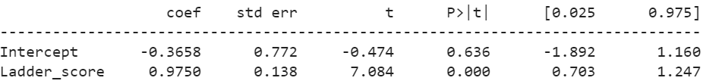
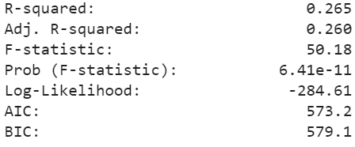
Predicting Max Rate -
Linear Regression
Is it possible to predict max rate of coronavirus infections using happiness?
Notes:
Next, to relate happiness to max infection rate, we performed a linear regression using happiness score as a predictor of max rate resulted in a poor R² of 0.265 (Figure 5) and an out-of-sample RMSE of 1.87, which is within one standard deviation of the log max infection rate from the original data (Table 1). Moreover, the p-value of essentially 0, along with non-zero confidence intervals for the happiness score, show that happiness is a significant variable in the model. Overall, we can infer from this model that happiness, or more specifically, some predictors of happiness are also significant predictors of the max infection rate.

Slide 11
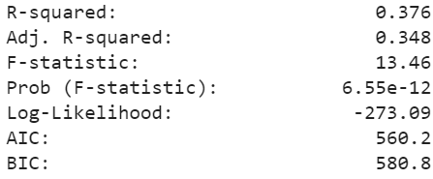
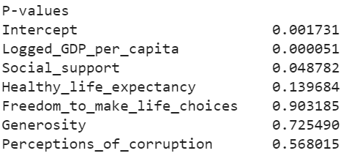
Predicting Max Rate
Using all the predictors of happiness...
Notes:
So naturally, we created a model using all the predictors of happiness to isolate the most important shared predictors.
Resulted in an R^2 of 0.376 which is higher than using the happiness ladder score alone, which had an R^2 0.265. However, several variables have p-values greater than 0.05 which prompted us to further refine our model.

Slide 12
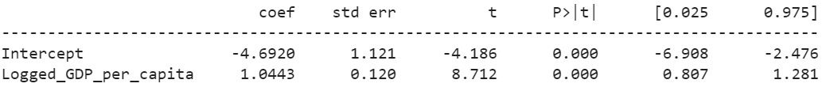
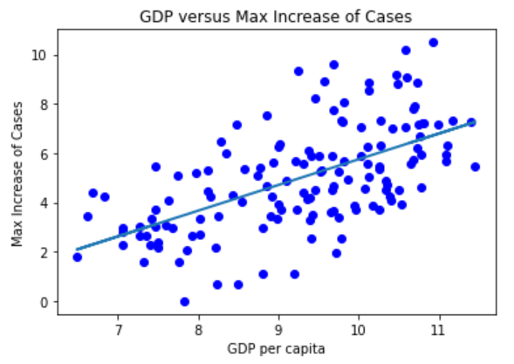
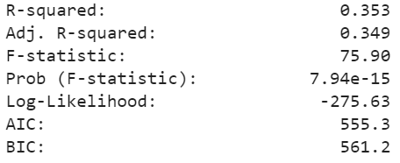
Predicting Max Rate
Isolating the best predictors...
RMSE: 1.753
Notes:
Upon optimizing R^2 and and out-of-sample RMSE
Of the most significant happiness predictors, we found that log GDP per capita is the most significant predictor of max infection rate. This produced a slightly lower R² of 0.353 compared to using all the predictors of happiness. But is still higher than that obtained using happiness rating alone to predict max rate. This is likely because of factors that may be effective predictors of happiness, but poor predictors of max rate. Additionally, an out-of-sample RMSE of 1.75 was obtained which is improved from the 1.87 received from using happiness score alone.

Slide 13


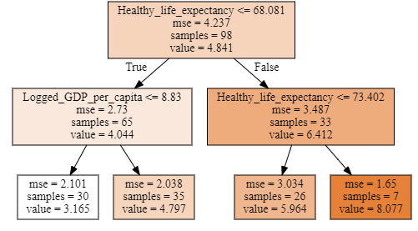
Predicting Max Rate - Regression Tree
What does the regression tree say?
RMSE: 2.10
Notes:
The four happiness predictors that were previously determined as important predictors were also used in a regression tree analysis. The results contradicted those found by the linear regression by selecting healthy life expectancy as the most significant predictor of log max infection rate (Figure 7). This can be seen by the importance summary above the tree displayed on this slide. However, the regression tree also produced a significantly worse RMSE of 2.09 which is greater than one standard deviation of the log max rate (2.05). Analyzing the tree itself, countries with both healthy life expectancy and logged GDP per capita have higher max rates. Could improve with more branches.

Slide 14
Conclusions
Correlation does not imply causation...
Happiness alone is a poor predictor of coronavirus cases in a country
Of the happiness predictors, GDP per capita is the most significant in predicting the max rate in a given country
Less accurate regression tree shows that healthy life expectancy is the most significant predictor
Positive relationship in countries of high values of both predictors could be due to increased testing => more detected cases
Uncovering more underlying factors could further improve the model
Notes:
From our analyses, we found that a small factor in predicting how severe a spike is in a country where confirmed COVID cases are unknown or inaccurate is happiness - specifically GDP per capita. This can be concluded from our linear regression model which had the lowest RMSE compared to our regression tree model. However, correlation does not necessarily imply causation. Both qualities are attributed to wealthier countries. It is almost unintuitive to think that wealthier countries have more cases of coronavirus, however, these results can be interpreted as countries with higher GDP per capita and healthy life expectancy likely leads to more reported cases because of increased testing - so more cases are detected. Only with more statistical testing and the addition of more significant, underlying variables can the model be improved to better predict pandemic response of a country, so their government can better prepare for the future.

